Slide 1
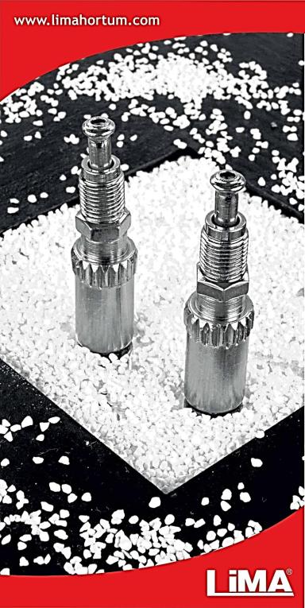
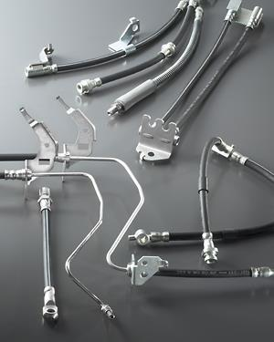
Hydraulic Brake & Clutch Hoses with Fittings Hidrolik Fren & Debriyaj Hortumları
Presentation
30.03.2018

Slide 2
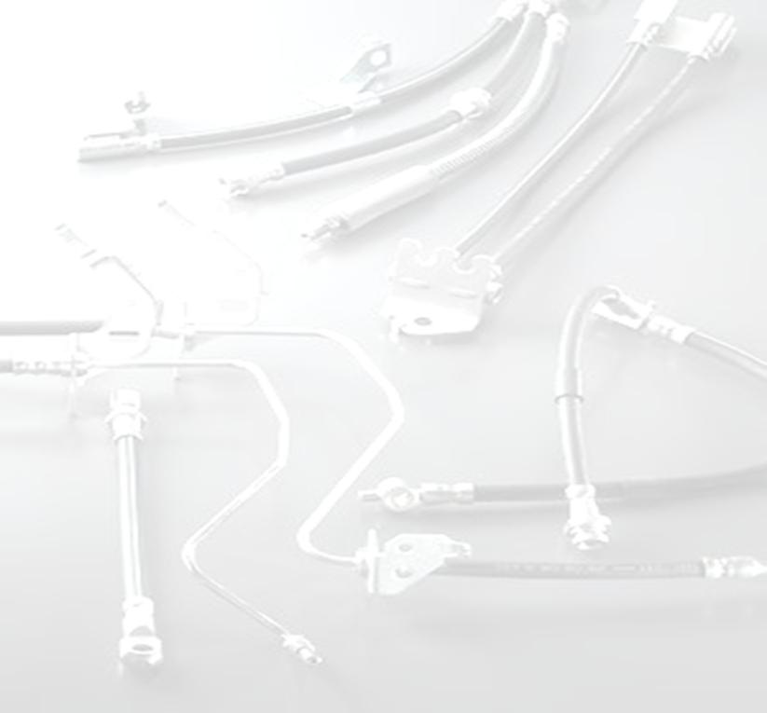
History
LiMA Hortum Sanayi, has been established in 1982 in Istanbul Turkey and produces brake hoses with fittings.
LiMA is also the local main distributor of SEL Hoses, the leader in their field.
LiMA is one of the leading companies its field, in sales of all kinds of hoses both with and/or without fittings. Also, in 2006 LiMA added hydraulic hoses assembly in its production line.
LiMA achieved the ISO 9001:2000 quality system certificate in 2004, further improving the quality of our service. Than updated to ISO 9001:2008 on 18.March.2010. Our company has achieved lately the ISO/TS 16949:2009 on 2012. On the first quarter of 2015 also have added ISO 14001:2004 and the OHSAS 18001:2007 Certifications.
LiMA has been exporting to leading companies around the world both in OE and aftermarket, with its quality proven products and services. With over 30 years of experience, our main goal is providing quality products with quality service.

Slide 3
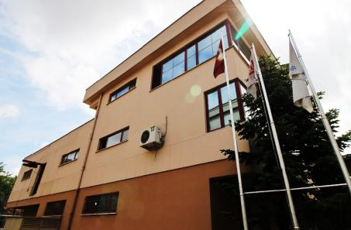
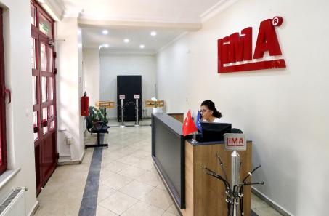
Lima Hortum Sanayi ve Ticaret Ltd. Şti.
Founded in:
1982
Main Production:
Brake & Clutch Hoses with Fittings
Sub Productions:
Hydraulic Hoses and Fittings
Total Production Area:
1200 m2
Nr. of direct workers:
18
Quality Certificates:
ISO 9001
ISO / TS 16949
OHSAS 18001
ISO 14001

Slide 4
Lima Hoses, Company presentation
Organizational Chart
Management
General Manager
Business Management
Vice General Manager
Resources Management
Finance & Adminis. Manager
Engineering
Quality Manager
Purchasing
Purchasing Responsible
Sales
Vice General Manager
Facility Management
Finance & Adminis. Manage
Finance
Finance & Adminis. Manager
HR & Administra.
Finance & Adminis. Manage
Warehouse
Warehouse Responsible
Metal Works
CNC Operators,
Pin Assembly Operator,
Welding Operator
Assembling
Hose Cutting Operator, Assembly Operator, Bending Operator
Product Development
PD Engineer,
Technical Draftsman
Quality
Quality Manager
Domestic Trade
Sale Responsible
Exportation
Vice General Manager
C. Public Accountant
Consultant
IT
Consultant
Production
Production Manager
Quality Control
Quality Responsible,
Quality Control Operators
System Management
Quality Manager, Quality Responsible

Slide 5
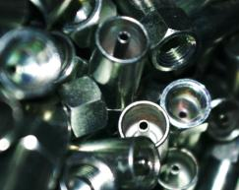
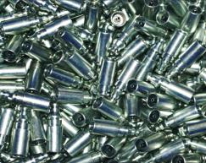
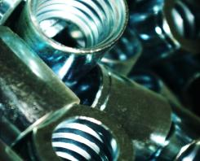
Lima Hoses, Company presentation
Product Ranges : Metal Fittings
Lima manufactures over 500 diffrent fittings type in its inventory via her CNC machining lines.
FITTINGS
FEMALE
Orfice
Reverse Orfice
BANJO
Circular
MALE
Square
ADAPTER
With Pin
Without Pin

Slide 6
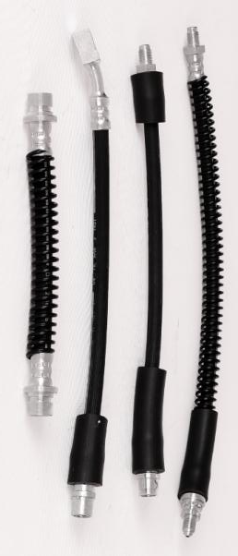
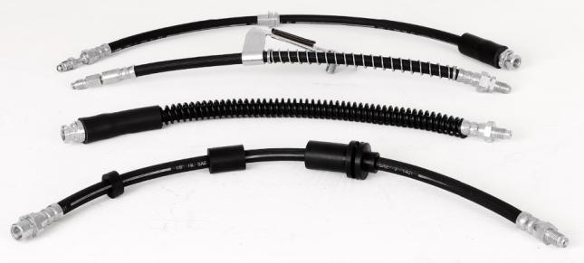
Lima Hoses, Company presentation
Product Ranges : Brake Hoses
Over 2000 different OE Suitable brake hoses in serial production.
Product development project for over 1500 new OE Suitable products for aftermarket.

Slide 7
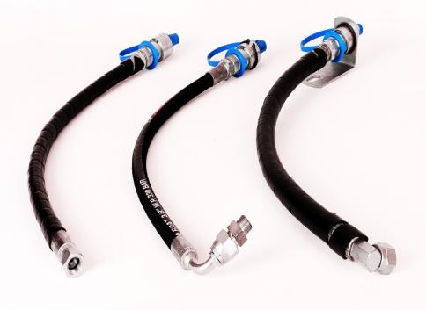
Lima Hoses, Company presentation
Product Ranges : Hydraulic Hoses
Hydraulic hoses with fittings for trucks and
agricultural vehicles, are also a growing
demand from our local market

Slide 8
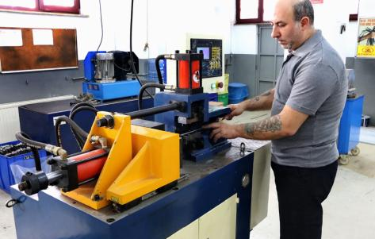
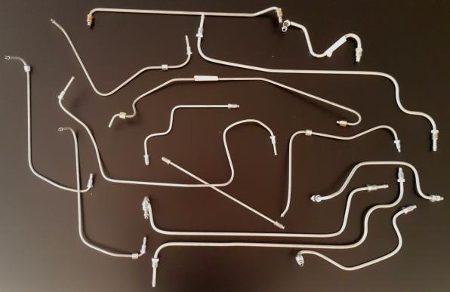
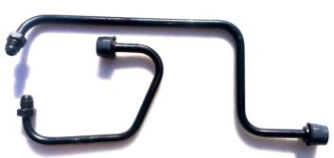
Lima Hoses, Company presentation
Product Ranges :
Bended Steel Pipes for various applications

Slide 9
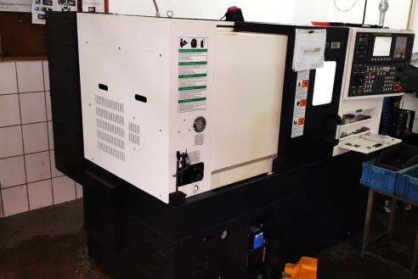
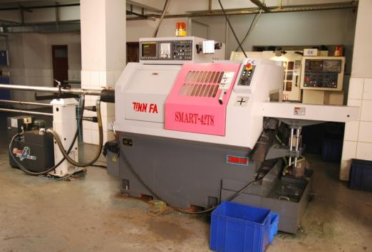
Presentation of Lima
Production Capability : Metal Work
4 CNC automat
4 Revolver
2 Upright Drill
2 Pneumatic Press
1 Eccentric Press
1 Induction Welding Machine

Slide 10
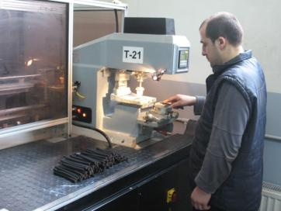
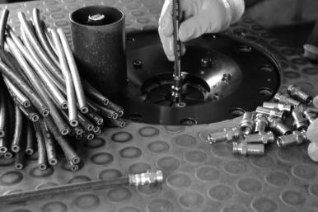
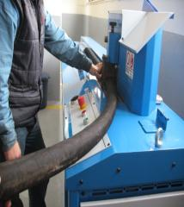
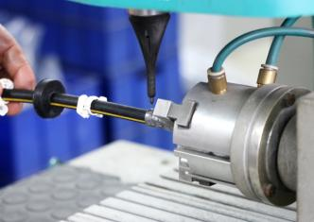
Lima Hoses, Company presentation
Production Capability : Hose Assembly
2 Hose Cutting Machine
3 Crimping Machine
1 Flaring Machine
1 Pipe Bending Apparatus
1 Benchtop Marking

Slide 11
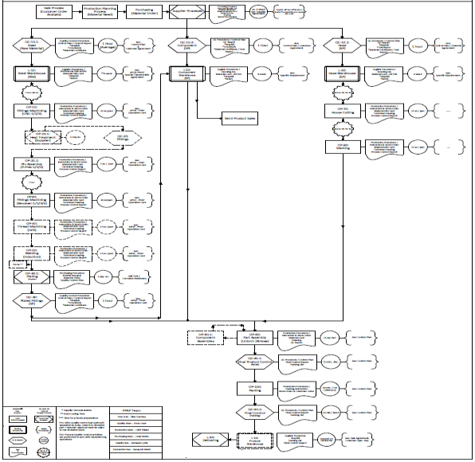
Lima Hoses, Company presentation
Production Capability : Process Flow & Capacity
4000 pcs/day fittings production - 3000 pcs/day hose assembly - 1000 pcs/day bended pipe production

Slide 12
Lima Hoses, Company presentation
Quality Assurance / Product Validation
Brake Hose Validation Tests
Brake hose validation tests performed by our hose manufacturer supplier in its laboratory accredited according to ISO 17025. Lima is periodicly repeating some of the most important tests for crosscheck.
Test Name | Supplier Performing Period | Lima Performing Period
Dimension | Every Batch | Every batch on Incoming Control
%100 Pressure | Every Batch | 5 pcs on every batch
Constriction | DOT certification period | %100 on Final Control
Volumetric Expansion | DOT certification period
Brake Fluid Compatibility | DOT certification period
Whip | DOT certification period | Every changes on production method or product design
Tensile | DOT certification period
Cold Bend | DOT certification period
Ozone & Dynamıc Ozone | DOT certification period
Corrosion Resistance | DOT certification period
Water Absorption | DOT certification period
Hot Impulse | DOT certification period
Burst | Every Batch | Every changes on production method or product design

Slide 13
Lima Hoses, Company presentation
Quality Assurance / Product Validation
Clutch Hose Validation Parameters
Test Name | SEL | Lima | Validation of … | Validated By …
Dimension | X | X | Rubber hose & fittings dimension | Measurement & SPC for SC&CC
%100 Pressure | X | X | Leakprofing of the assembly | Pressure Test
Constriction |  | X | Crimping Process | Apparatus control
Volumetric Expansion | X |  | Textile quality of rubber hose | Dia. Measurement under pressure
Brake Fluid Compatibility | X |  | Inner tube quality of rubber hose | ageing test
Whip | X | X | Crimping quality of assembly & textile quality of rubber hose | Endurance test under pressure
Tensile | X |  | Crimping quality of assembly & textile quality of rubber hose | Tensile test
Cold Bend | X |  | Rubber quality | ageing Test
Ozone & Dynamıc Ozone | X |  | Rubber quality | ageing Test
Corrosion Resistance |  | X | Plating quality | Salt Sprey test
Water Absorption | X |  | Rubber quality | ageing Test
Hot Impulse | X |  | Crimping & rubber quality | Endurance Test
Burst | X | X | Crimping & rubber quality | Endurance Test

Slide 14
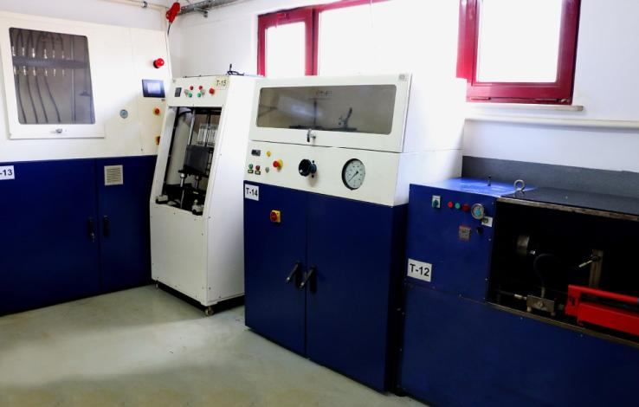
Lima Hoses, Company presentation
Quality Assurance / Lima’s pressure test equipments
Leaking test (22 bar air / 10 sec)
Burst test (2500 bar)
Leaking test
(280 bar hydraulic
/ 10 sec)
Whip test
(36h / 18 bar / 800 rpm)

Slide 15
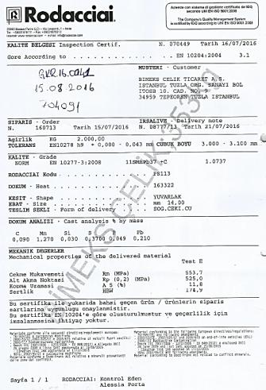
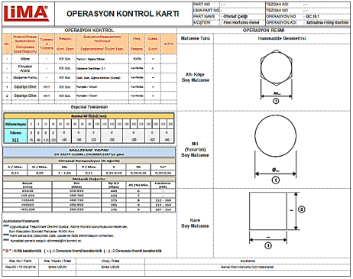
Lima Hoses, Company presentation
Quality Assurance / Incoming Control

Slide 16
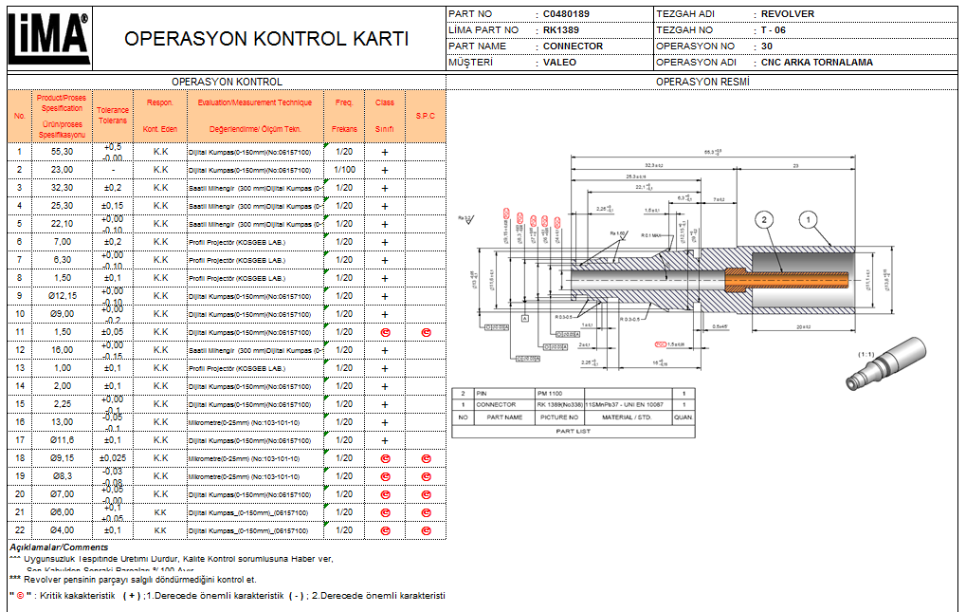
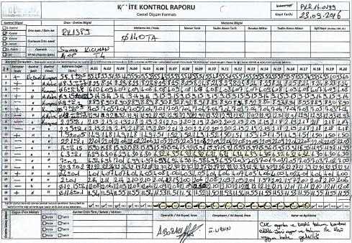
Lima Hoses, Company presentation
Quality Assurance / Process Control

Slide 17
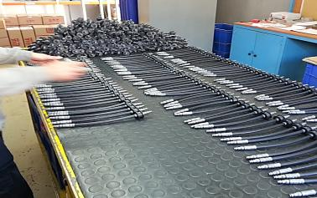
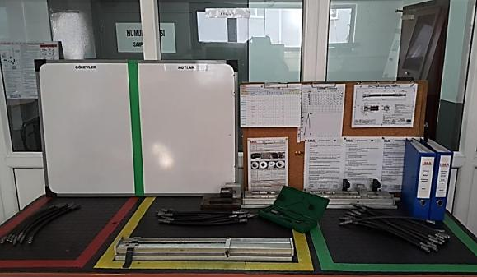
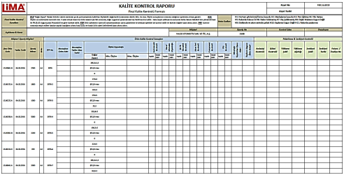
Lima Hoses, Company presentation
Quality Assurance / Final Quality Control
100% Control for OE parts

Slide 18
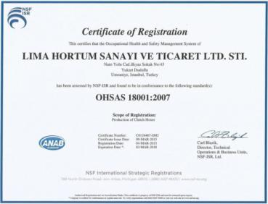
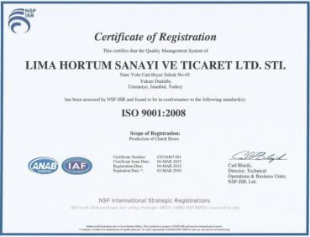
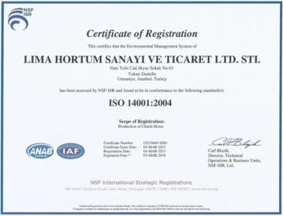
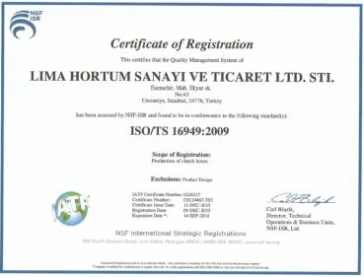
Lima Hoses, Company presentation
Certificates
Lima management system meets the requirements of ISO 9001, ISO 14001, OHSAS 18001 and ISO/TS 16949 (Excluding 7.3)

Slide 19
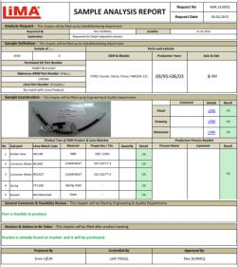
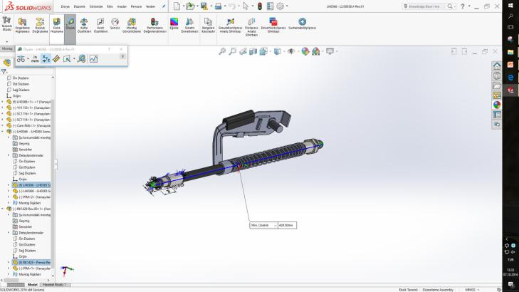
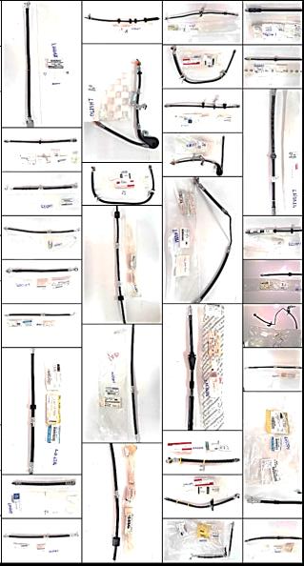
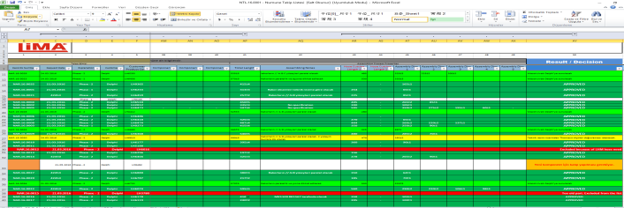
Future Projects
Product Dev. / Updating of Product Range
Development of
1500 type brake hose
for a new customer

Slide 20
Main Customers
Due to our confidentiality agreements with our customers, their names will not be shown on this presentation.
www.limahortum.com

Slide 21
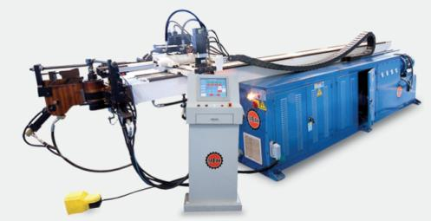
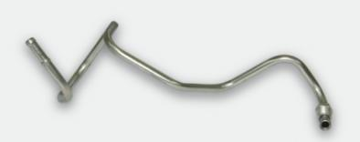
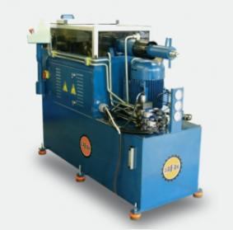
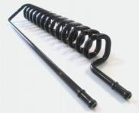
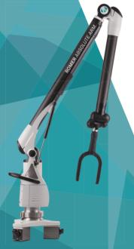
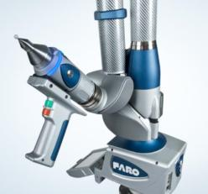
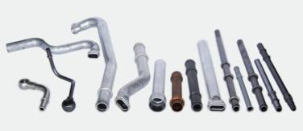
Future Projects
Growth / Installation of new pipe bending process
CNC Bending
CNC Flaring
CMM
Measure
TOTAL planned investment amount $≈200.000 €$

Slide 22
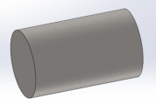
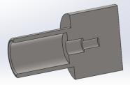
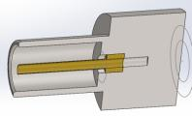
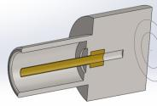
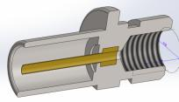
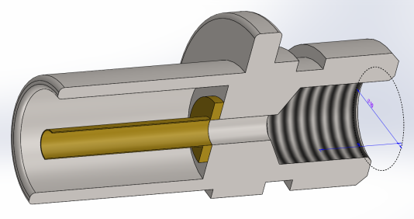
Future Projects
R&D Activities / Welding +QC Unit Project
Current Production Process
Pin Assembly with Stud Welding

Slide 23
Future Projects
R&D Activities / Welding+QC Unit Project
Work Stations
1
Fittings feeding
Cleanning with air
3
Leakage control (20 bar / 5s – 10s)
2
4
5
6
7
8
9
10
Optical dimension control
Bad part rejection
Welding
Optical control (Concentrisity, congestion)
Bad part rejection
Reaming
Cleanning with air
11
12
13
14
Bad part rejection
Fracture control (Optional)
Bad part rejection(Optional)
Lazer Marking (Optional)

Slide 24
Future Projects
Growth / Instalation of New Production Plant
R&D Workshop
Hose Assembly
Quality Control Lab.
Plating
Press
WH – Final Product
Welding
WH – Semi Product
Packing
Pipe Bending
Machinnig

Slide 25
LOCATION . . .
LİMA HORTUM SAN. & TİC. Ltd. Şti.
Esensehir Mah. ilkyaz Sk. No:43 – Ümraniye 34776
ISTANBUL - TURKIYE
Tel: +90 216 527 62 75 - 76
Fax: +90 216 527 62 77
e-mail: info@limahortum.com

